Slide 1
Chapter 6
Digital Design and Computer Architecture, 2nd Edition
David Money Harris and Sarah L. Harris

Slide 2
Introduction
Architecture: programmer’s view of computer
Defined by instructions & operand locations
Microarchitecture: how to implement an architecture in hardware (covered in Chapter 7)

Slide 3
Assembly Language
Instructions: commands in a computer’s language
Assembly language: human-readable format of instructions
Machine language: computer-readable format (1’s and 0’s)
MIPS architecture:
Developed by John Hennessy and his colleagues at Stanford and in the 1980’s.
Used in many commercial systems, including Silicon Graphics, Nintendo, and Cisco
Once you’ve learned one architecture, it’s easy to learn others

Slide 4
Architecture Design Principles
Underlying design principles, as articulated by Hennessy and Patterson:
Simplicity favors regularity
Make the common case fast
Smaller is faster
Good design demands good compromises

Slide 5
Instructions: Addition
add: mnemonic indicates operation to perform
b, c: source operands (on which the operation is performed)
a: destination operand (to which the result is written)
C Code
a = b + c;
MIPS assembly code
add a, b, c

Slide 6
Instructions: Subtraction
Similar to addition - only mnemonic changes
sub: mnemonic
b, c: source operands
a: destination operand
C Code
a = b - c;
MIPS assembly code
sub a, b, c

Slide 7
Design Principle 1
Simplicity favors regularity
Consistent instruction format
Same number of operands (two sources and one destination)
easier to encode and handle in hardware

Slide 8
Multiple Instructions
More complex code is handled by multiple MIPS instructions.
C Code
a = b + c - d;
MIPS assembly code
add t, b, c # t = b + c
sub a, t, d # a = t - d

Slide 9
Design Principle 2
Make the common case fast
MIPS includes only simple, commonly used instructions
Hardware to decode and execute instructions can be simple, small, and fast
More complex instructions (that are less common) performed using multiple simple instructions
MIPS is a reduced instruction set computer (RISC), with a small number of simple instructions
Other architectures, such as Intel’s x86, are complex instruction set computers (CISC)

Slide 10
Operands
An instruction operates on operands.
Operands can be stored in registers or memory, or may be constants (also called immediates) stored in the instruction itself.

Slide 11
Operands: Registers
MIPS has 32 32-bit registers
Registers are faster than memory
MIPS called “32-bit architecture” because it operates on 32-bit data

Slide 12
Design Principle 3
Smaller is Faster
MIPS includes only a small number of registers

Slide 13
MIPS Register Set
Name | Register Number | Usage
$0 | 0 | the constant value 0
$at | 1 | assembler temporary
$v0-$v1 | 2-3 | Function return values
$a0-$a3 | 4-7 | Function arguments
$t0-$t7 | 8-15 | temporaries
$s0-$s7 | 16-23 | saved variables
$t8-$t9 | 24-25 | more temporaries
$k0-$k1 | 26-27 | OS temporaries
$gp | 28 | global pointer
$sp | 29 | stack pointer
$fp | 30 | frame pointer
$ra | 31 | Function return address

Slide 14
Operands: Registers
Registers:
$ before name
Example: $0, “register zero”, “dollar zero”
Registers used for specific purposes:
$0 always holds the constant value 0.
the saved registers, $s0-$s7, used to hold variables
the temporary registers, $t0 - $t9, used to hold intermediate values during a larger computation
Discuss others later

Slide 15
Instructions with Registers
Revisit add instruction
C Code
a = b + c
MIPS assembly code
# $s0 = a, $s1 = b, $s2 = c
add $s0, $s1, $s2

Slide 16
Operands: Memory
Too much data to fit in only 32 registers
Store more data in memory
Memory is large, but slow
Commonly used variables kept in registers

Slide 17
Word-Addressable Memory
Each 32-bit data word has a unique address

Slide 18
Reading Word-Addressable Memory
Memory read called load
Mnemonic: load word (lw)
Format:
lw $s0, 5($t1)
Address calculation:
add base address ($t1) to the offset (5)
Effective address = ($t1 + 5)
Result:
$s0 holds the value at address ($t1 + 5)
Any register may be used as base address

Slide 19
Reading Word-Addressable Memory
Example: read a word of data at memory address 1 into $s3
address = ($0 + 1) = 1
$s3 = 0xF2F1AC07 after load
Assembly code
lw $s3, 1($0) # read memory word 1 into $s3
Hexadecimal constants are written with the prefix 0x.
By contention, memory is drawn with low memory addresses toward the bottom and high memory addresses towards the top

Slide 20
Writing Word-Addressable Memory
Memory write are called store
Mnemonic: store word (sw)

Slide 21
Writing Word-Addressable Memory
Example: Write (store) the value in $t4 into memory address 7
add the base address ($0) to the offset (0x7)
address: ($0 + 0x7) = 7
Offset can be written in decimal (default) or hexadecimal
Assembly code
sw $t4, 0x7($0) # write the value in $t4
# to memory word 7

Slide 22
Byte-Addressable Memory
Each data byte has unique address
Load/store words or single bytes: load byte (lb) and store byte (sb)
32-bit word = 4 bytes, so word address increments by 4

Slide 23
Reading Byte-Addressable Memory
The address of a memory word must now be multiplied by 4. For example,
the address of memory word 2 is 2 × 4 = 8
the address of memory word 10 is 10 × 4 = 40 (0x28)
MIPS is byte-addressed, not word-addressed

Slide 24
Reading Byte-Addressable Memory
Example: Load a word of data at memory address 4 into $s3.
$s3 holds the value 0xF2F1AC07 after load
MIPS assembly code
lw $s3, 4($0) # read word at address 4 into $s3

Slide 25
Writing Byte-Addressable Memory
Example: stores the value held in $t7 into memory address 0x2C (44)
MIPS assembly code
sw $t7, 44($0) # write $t7 into address 44

Slide 26
Design Principle 4
Good design demands good compromises
Multiple instruction formats allow flexibility
add, sub: use 3 register operands
lw, sw: use 2 register operands and a constant
Number of instruction formats kept small
to adhere to design principles 1 and 3 (simplicity favors regularity and smaller is faster).

Slide 27
Operands: Constants/Immediates
lw and sw use constants or immediates
immediately available from instruction
16-bit two’s complement number
addi: add immediate
Subtract immediate (subi) necessary?
C Code
a = a + 4;
b = a – 12;
MIPS assembly code
# $s0 = a, $s1 = b
addi $s0, $s0, 4
addi $s1, $s0, -12

Slide 28
Machine Language
Binary representation of instructions
Computers only understand 1’s and 0’s
32-bit instructions
Simplicity favors regularity: 32-bit data & instructions
3 instruction formats:
R-Type: register operands
I-Type: immediate operand
J-Type: for jumping (discuss later)

Slide 29
R-Type
Register-type
3 register operands:
rs, rt: source registers
rd: destination register
Other fields:
op: the operation code or opcode (0 for R-type instructions)
funct: the function
with opcode, tells computer what operation to perform
shamt: the shift amount for shift instructions, otherwise it’s 0

Slide 30
R-Type Examples
Note the order of registers in the assembly code:
add rd, rs, rt

Slide 31
I-Type
Immediate-type
3 operands:
rs, rt: register operands
imm: 16-bit two’s complement immediate
Other fields:
op: the opcode
Simplicity favors regularity: all instructions have opcode
Operation is completely determined by opcode

Slide 32
I-Type Examples
Note the differing order of registers in assembly and machine codes:
addi rt, rs, imm
lw rt, imm(rs)
sw rt, imm(rs)

Slide 33
Machine Language: J-Type
Jump-type
26-bit address operand (addr)
Used for jump instructions (j)

Slide 34
Review: Instruction Formats

Slide 35
Power of the Stored Program
32-bit instructions & data stored in memory
The stored program offers general purpose computing
To run a new program:
No rewiring required
Simply store new program in memory
Program Execution:
Processor fetches (reads) instructions from memory in sequence
Processor performs the specified operation
The architectural state of a microprocessor holds the state of a program. For MIPS, it consists of the register file and a program counter (PC)

Slide 36
The Stored Program
Program Counter (PC): keeps track of current instruction

Slide 37
Interpreting Machine Code
Start with opcode: tells how to parse rest
If opcode all 0’s
R-type instruction
Function bits tell operation
Otherwise
opcode tells operation

Slide 38
Programming
High-level languages:
e.g., C, Java, Python
Written at higher level of abstraction
Common high-level software constructs:
if/else statements
for loops
while loops
arrays
function calls

Slide 39
Logical Instructions
and, or, xor, nor
and: useful for masking bits
Masking all but the least significant byte of a value:
0xF234012F AND 0x000000FF = 0x0000002F
or: useful for combining bit fields
Combine 0xF2340000 with 0x000012BC:
0xF2340000 OR 0x000012BC = 0xF23412BC
nor: useful for inverting bits:
A NOR $0 = NOT A
andi, ori, xori
16-bit immediate is zero-extended (not sign-extended)
nori not needed

Slide 40
Logical Instructions Example 1

Slide 41
Logical Instructions Example 1

Slide 42
Logical Instructions Example 2

Slide 43
Logical Instructions Example 2

Slide 44
Shift Instructions
sll: shift left logical
Example: sll $t0, $t1, 5 # $t0 <= $t1 << 5
srl: shift right logical
Example: srl $t0, $t1, 5 # $t0 <= $t1 >> 5
sra: shift right arithmetic
Example: sra $t0, $t1, 5 # $t0 <= $t1 >>> 5

Slide 45
Shift Instructions

Slide 46
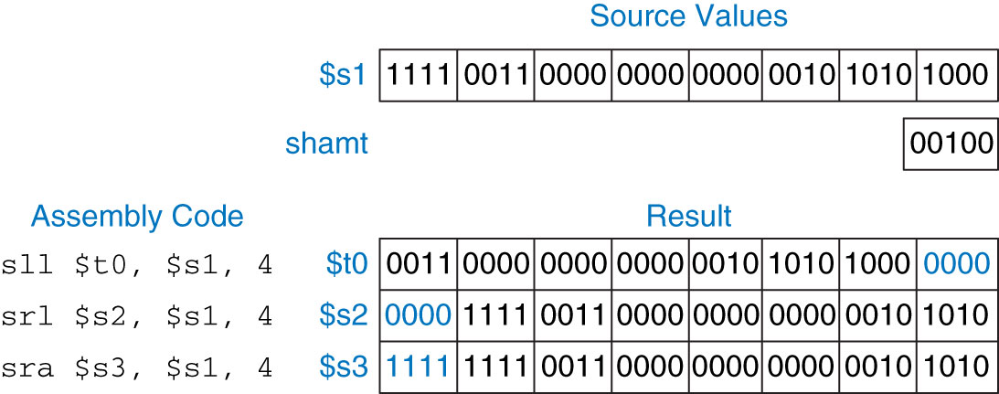
Shift Instructions

Slide 47
Branching
Execute instructions out of sequence
Types of branches:
Conditional
branch if equal (beq)
branch if not equal (bne)
Unconditional
jump (j)
jump register (jr)
jump and link (jal)

Slide 48
Review: The Stored Program

Slide 49
Conditional Branching (beq)
# MIPS assembly
addi $s0, $0, 4 # $s0 = 0 + 4 = 4
addi $s1, $0, 1 # $s1 = 0 + 1 = 1
sll $s1, $s1, 2 # $s1 = 1 << 2 = 4
beq $s0, $s1, target # branch is taken
addi $s1, $s1, 1 # not executed
sub $s1, $s1, $s0 # not executed
target: # label
add $s1, $s1, $s0 # $s1 = 4 + 4 = 8
Labels indicate instruction location. They can’t be reserved words and must be followed by colon (:)

Slide 50
The Branch Not Taken (bne)
# MIPS assembly
addi $s0, $0, 4 # $s0 = 0 + 4 = 4
addi $s1, $0, 1 # $s1 = 0 + 1 = 1
sll $s1, $s1, 2 # $s1 = 1 << 2 = 4
bne $s0, $s1, target # branch not taken
addi $s1, $s1, 1 # $s1 = 4 + 1 = 5
sub $s1, $s1, $s0 # $s1 = 5 – 4 = 1
target:
add $s1, $s1, $s0 # $s1 = 1 + 4 = 5

Slide 51
Unconditional Branching (j)
# MIPS assembly
addi $s0, $0, 4 # $s0 = 4
addi $s1, $0, 1 # $s1 = 1
j target # jump to target
sra $s1, $s1, 2 # not executed
addi $s1, $s1, 1 # not executed
sub $s1, $s1, $s0 # not executed
target:
add $s1, $s1, $s0 # $s1 = 1 + 4 = 5

Slide 52
Unconditional Branching (jr)
# MIPS assembly
addi $s0, $0, 0x2010
jr $s0
addi $s1, $0, 1
sra $s1, $s1, 2
lw $s3, 44($s1)
jr is an R-type instruction.
jr jumps to the address held in a register

